Slide 1

Activity 8.1: Performing File Operations Using NIO
  Problem Statement:
    Steve is a programmer in Global Systems Inc. He has been assigned a task to create a Java application that stores the following details about the computer products in a text file:
      Product ID
      Product name
      Product price
    In the preceding list, Product ID and Product name should accept a string value. Product price should accept a integer value.
    In addition, the application should store the following details about the shops that sell a product:
      Shop ID
      Shop name
      Address
    In the preceding list, Shop ID should accept an integer value. Shop name and Address should accept a string value.

Slide 2
Activity 8.1: Performing File Operations Using NIO (Contd.)
  Problem Statement (Contd.):
    As the details are added, they must be appended in the ProductDetails.txt file in the D:\Details directory. Further, you need to maintain the most recent copy the preceding files to the D:\Backup directory to ensure backup.

Slide 3

Activity 8.1: Performing File Operations Using NIO (Contd.)
  Solution: To perform the activity, refer the steps given in the embedded document.

Slide 4

Identifying the Layers in the JDBC Architecture
  Scenario:
To store and update the data in the SQL Server database.
To retrieve the data stored in the SQL Server database and present it to users in a proper format.
Needs to develop an Airline Reservation System application that communicates with a database.
A developer

Slide 5
Identifying the Layers in the JDBC Architecture (Contd.)
  Scenario (Contd.):
The developer needs to use the JDBC API to connect the Airline Reservation System application with the database.

Slide 6
JDBC Architecture
  Java applications cannot communicate directly with a database because a database can interpret only SQL statements and not Java language statements.
  You need a mechanism to translate Java statements into SQL statements.
  The JDBC architecture provides the mechanism for the preceding kind of translation.

Slide 7
JDBC Architecture (Contd.)
  The JDBC architecture has the following two layers:
JDBC driver layer
JDBC application layer
Signifies a Java application that uses the JDBC API to interact with the JDBC drivers.
Acts as an interface between a Java application and a database.
Contains a driver, such as the SQL Server driver or the Oracle driver, which enables connectivity to a database.

Slide 8
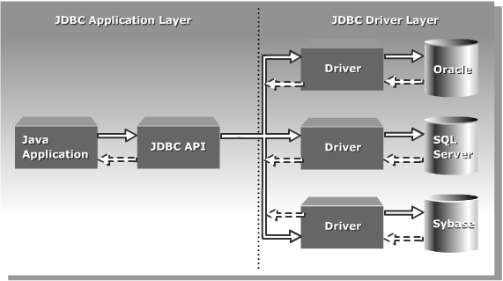
JDBC Architecture (Contd.)
  The following figure shows the JDBC architecture.

